Slide 1

Human Digestion
Part 1:Diet
Part 2: Digestive System
Physical Digestion
Chemical Digestion
Absorption

Slide 2
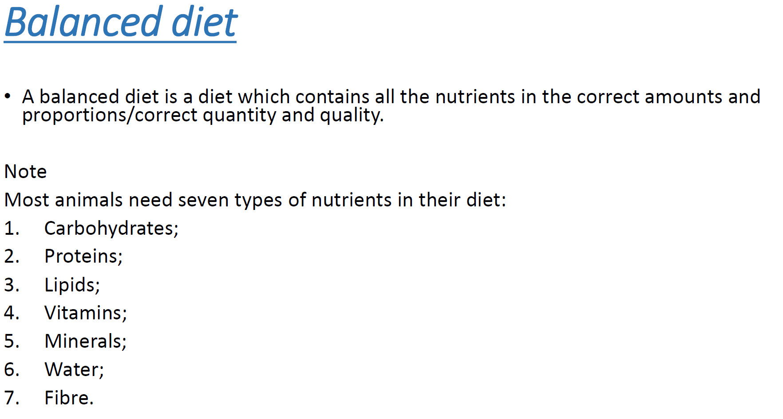

Slide 3
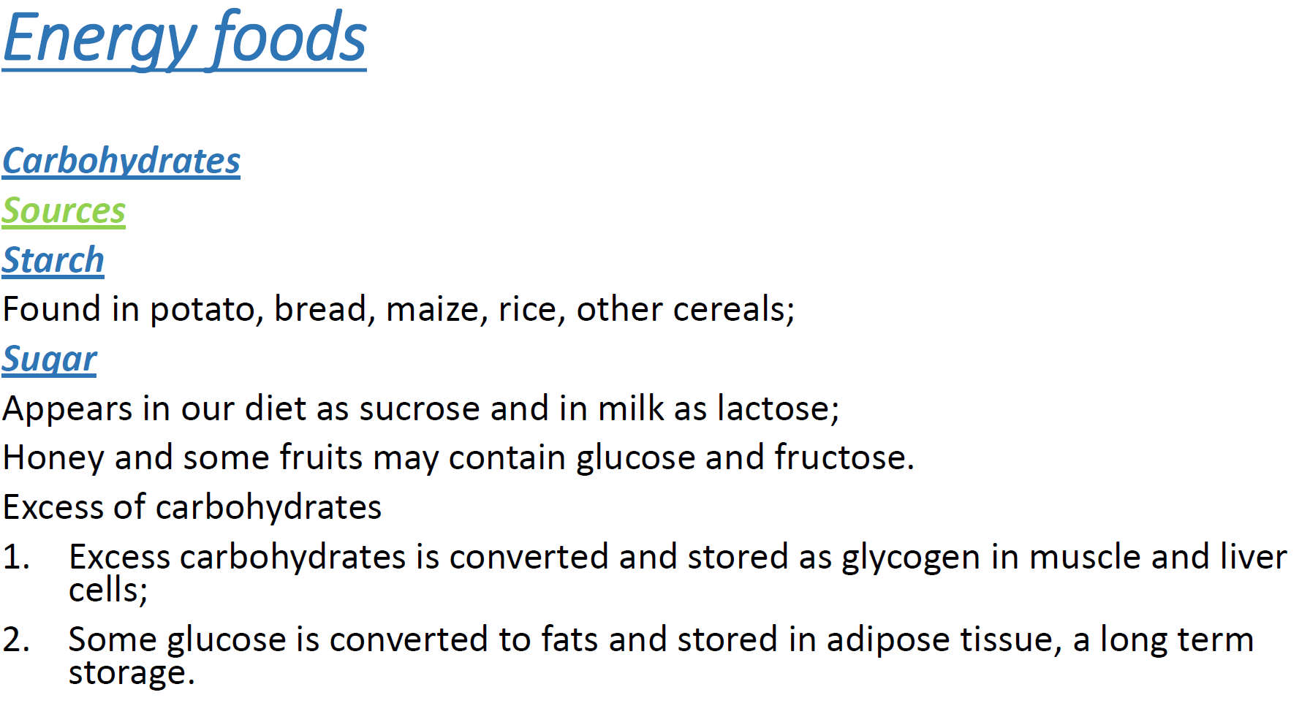

Slide 4
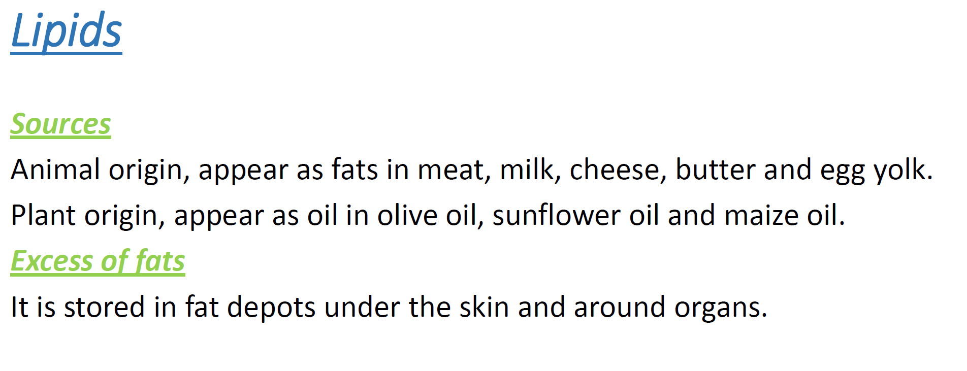

Slide 5
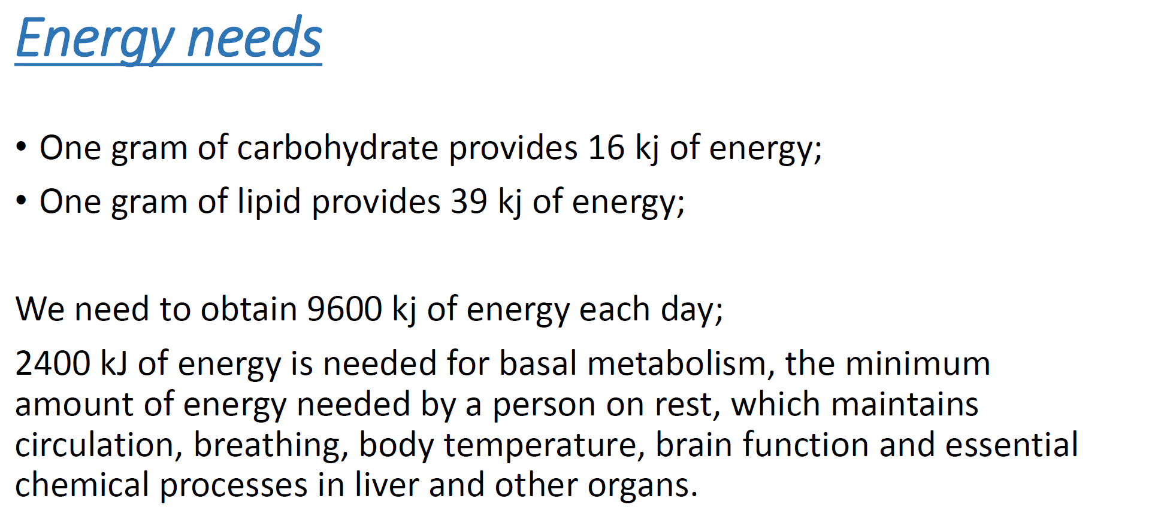

Slide 6
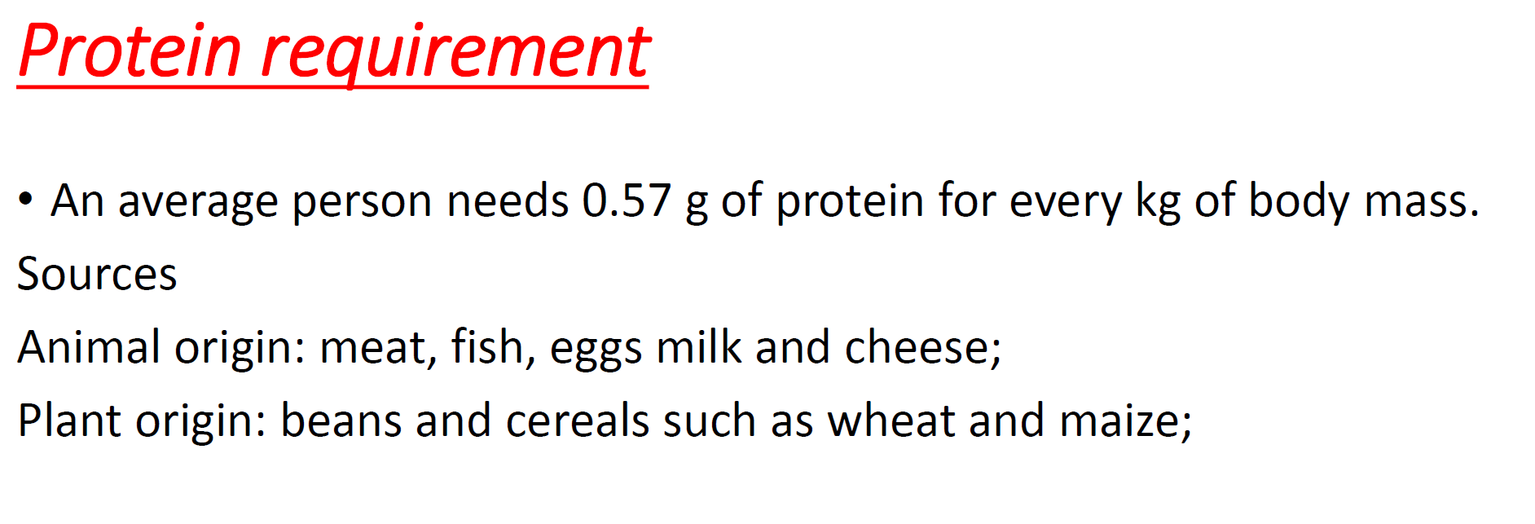

Slide 7
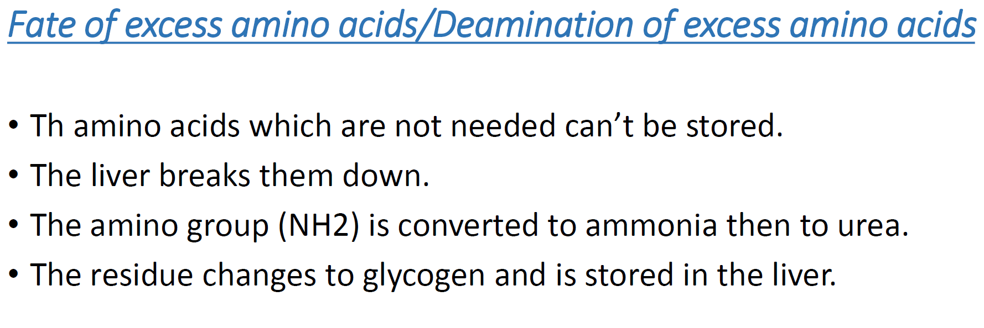

Slide 8
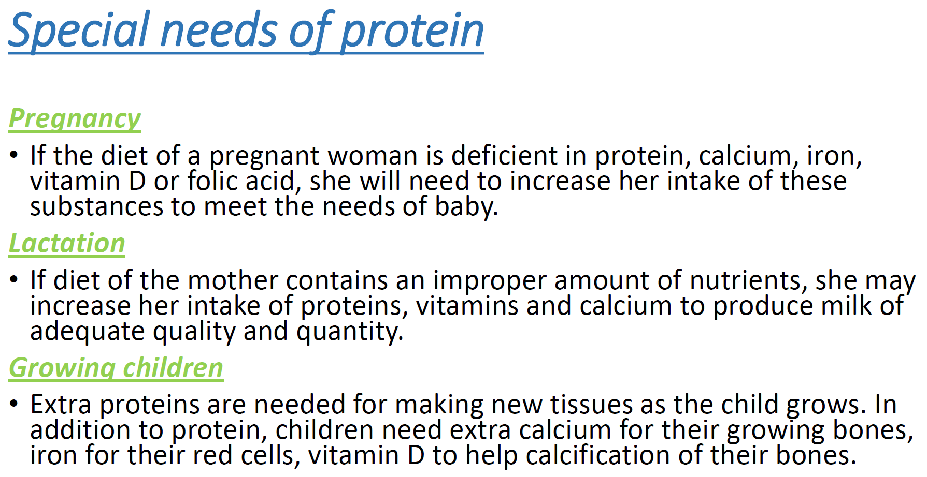

Slide 9
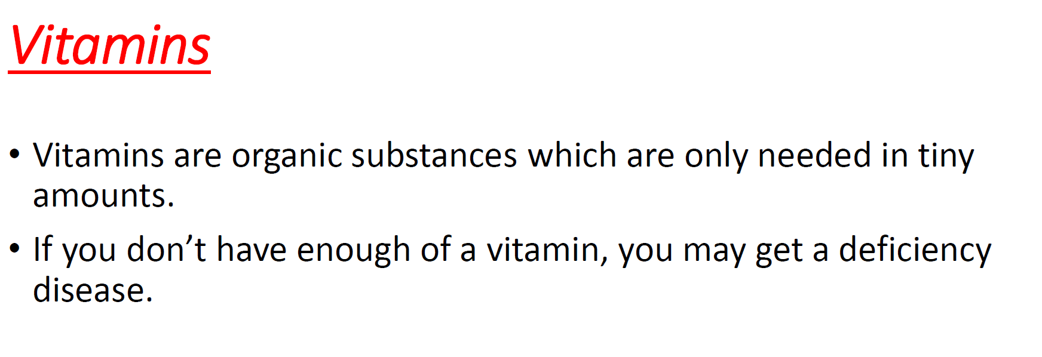

Slide 10
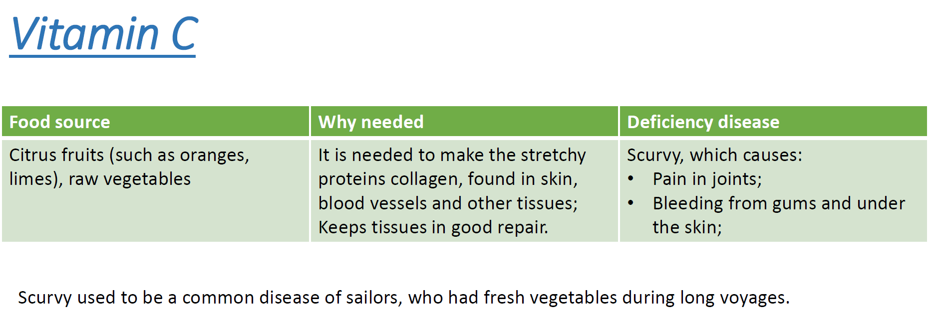

Slide 11
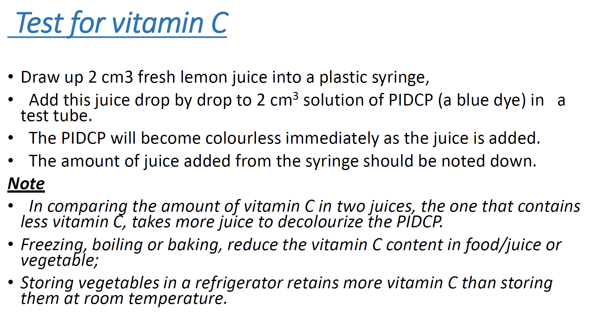

Slide 12
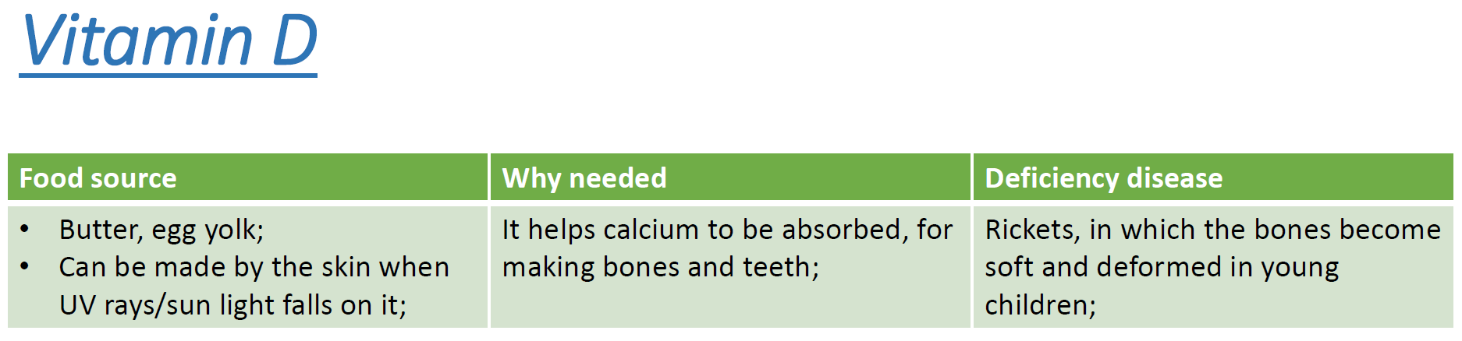

Slide 13
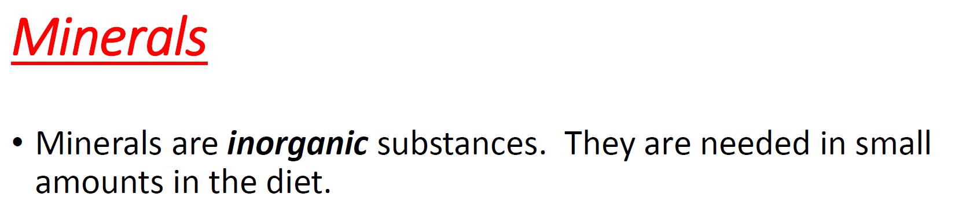
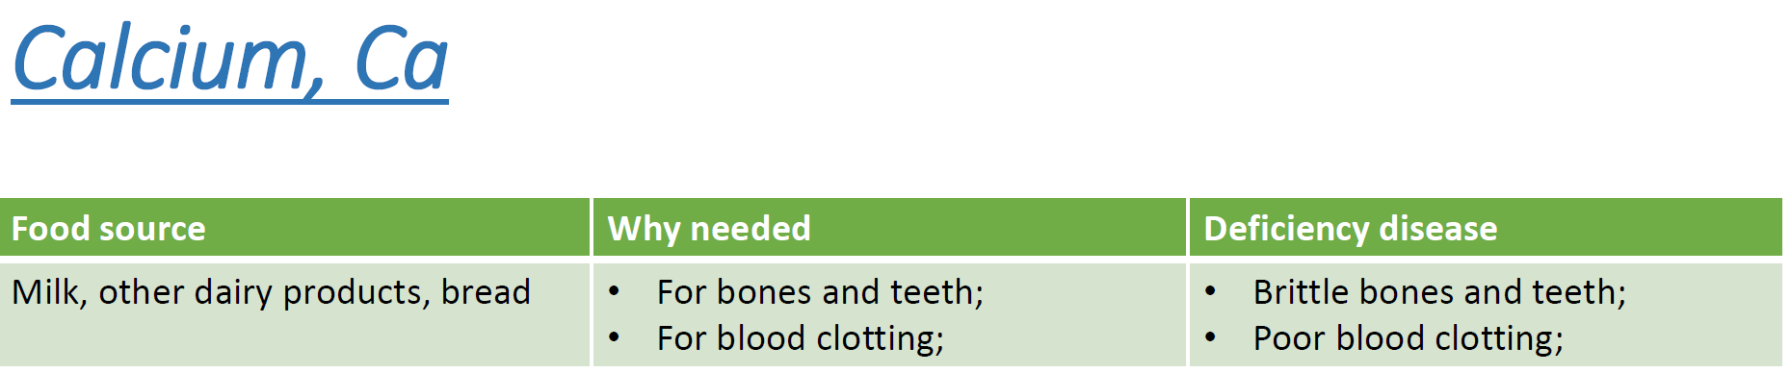

Slide 14
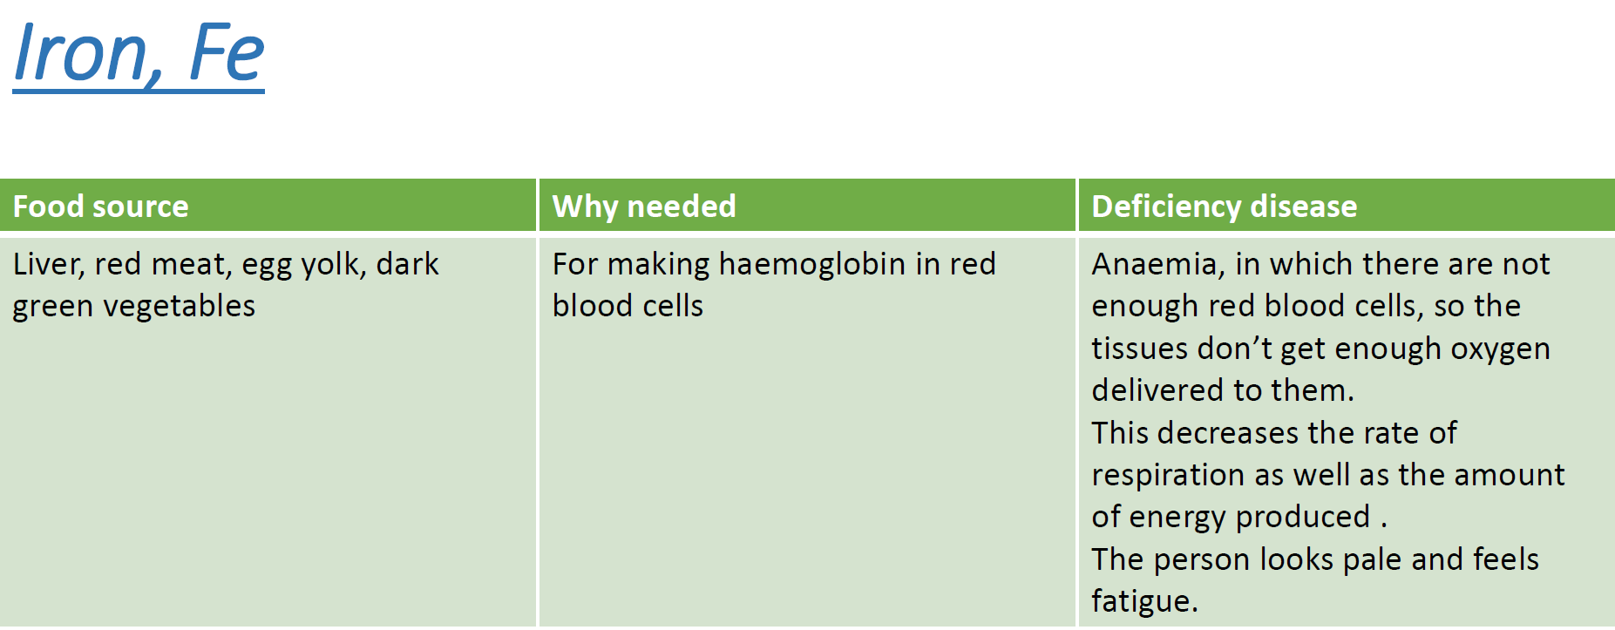

Slide 15
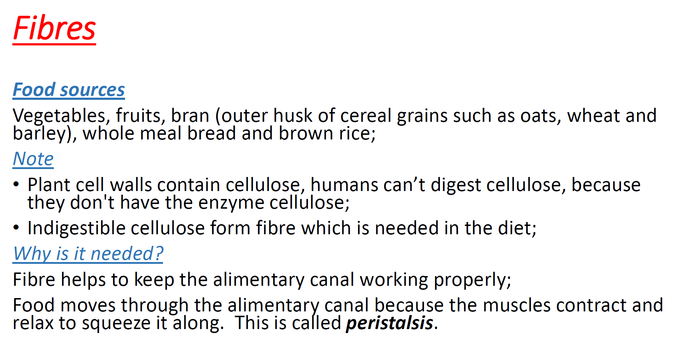

Slide 16
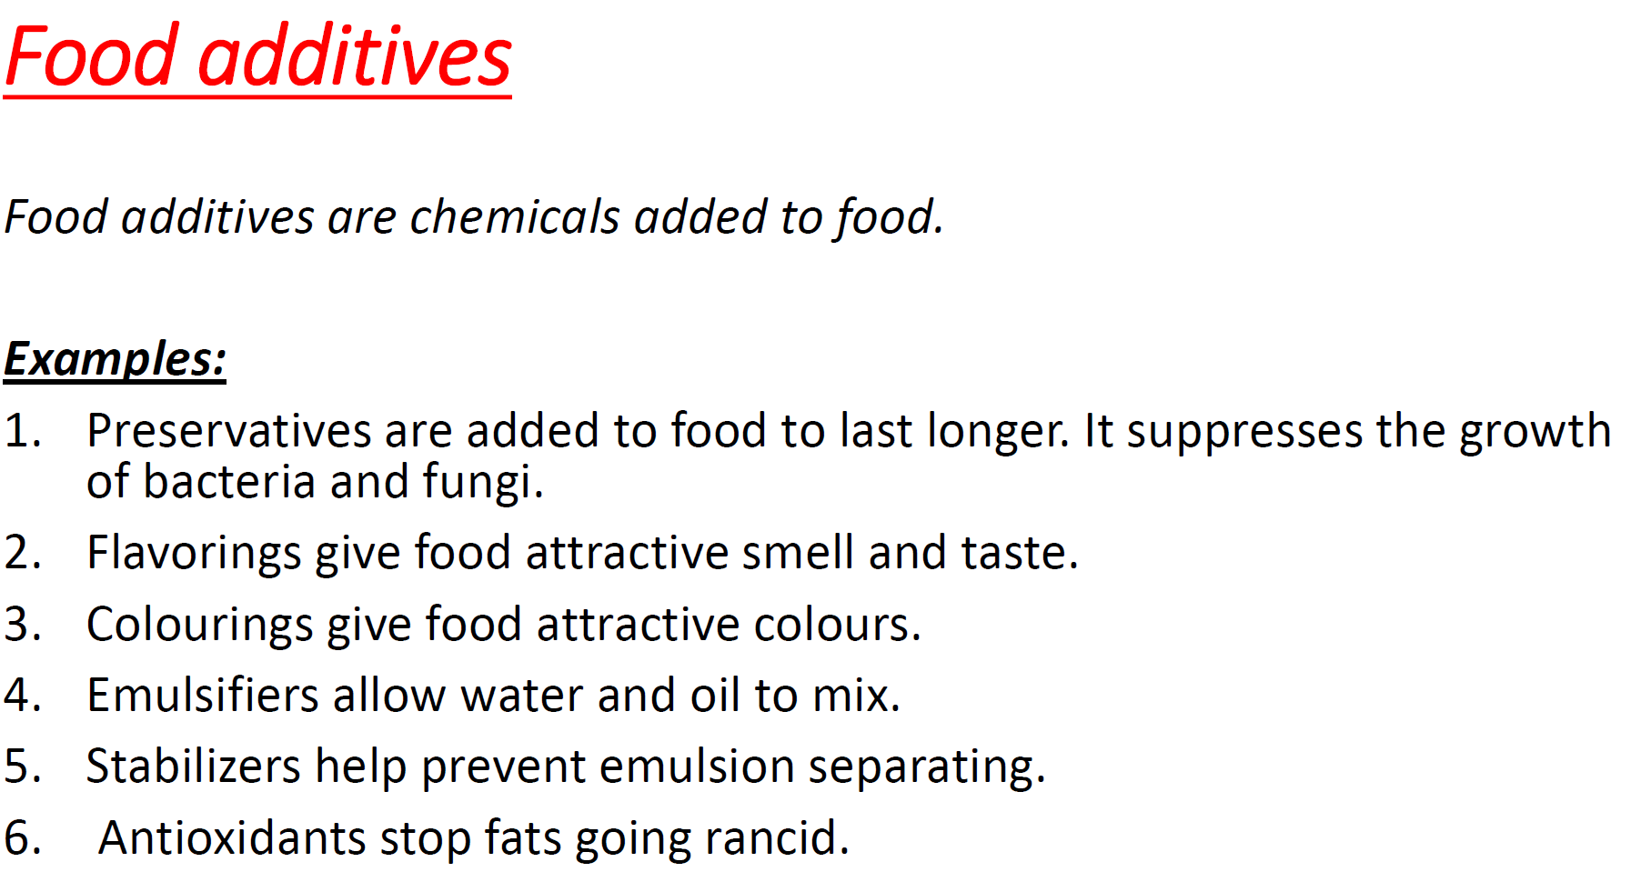

Slide 17
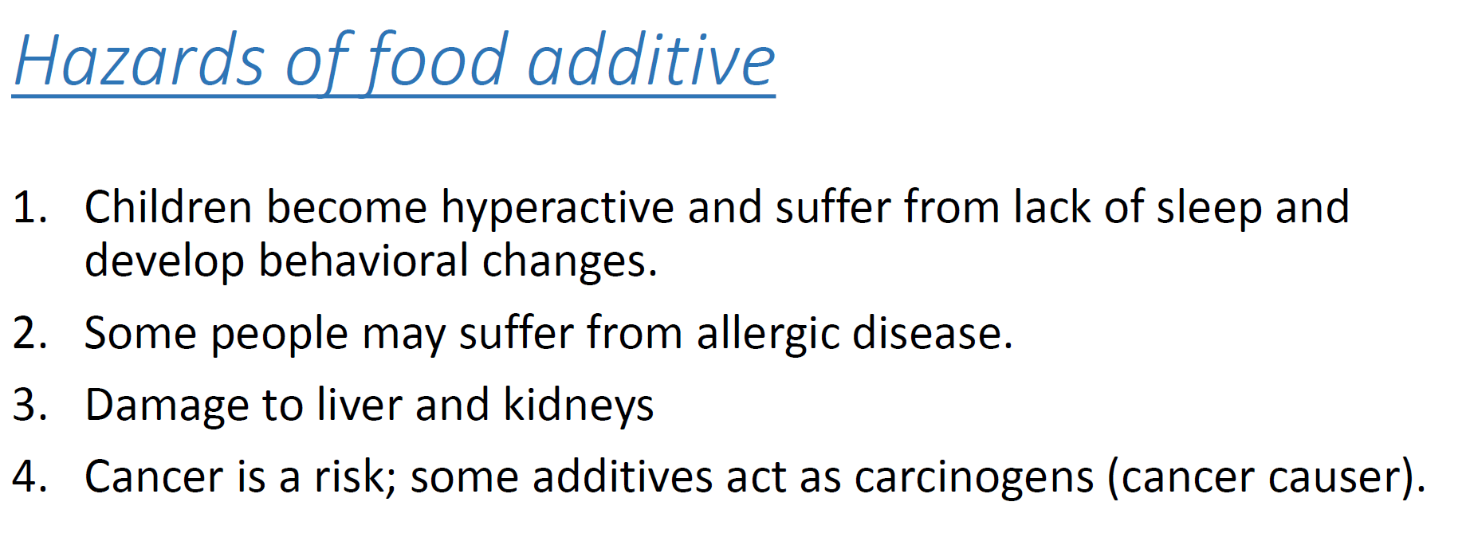

Slide 18
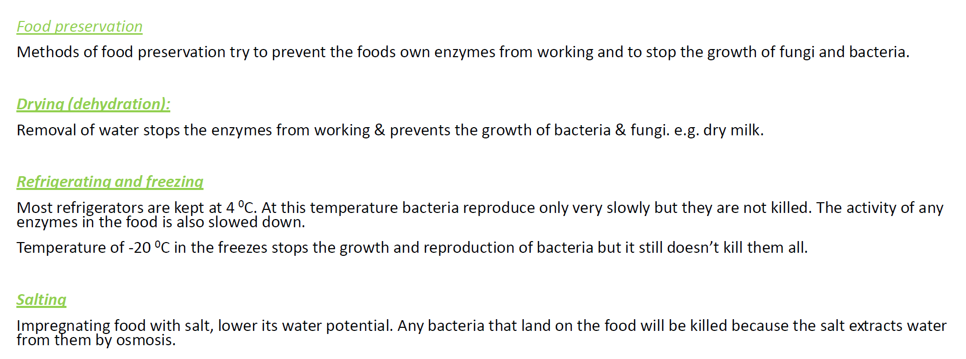

Slide 19
What is Nutrition?
Is the process by which organisms obtain food and energy for growth, repair and the maintenance of the body

Slide 20
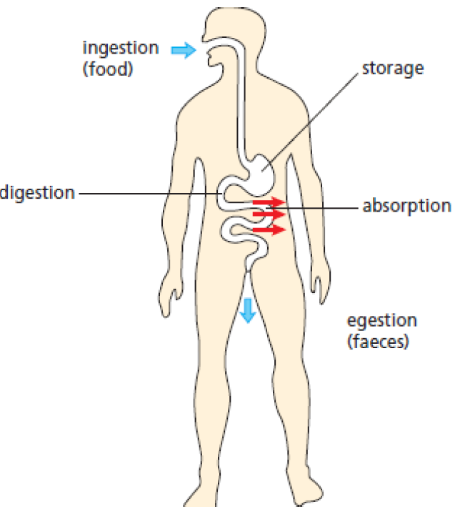
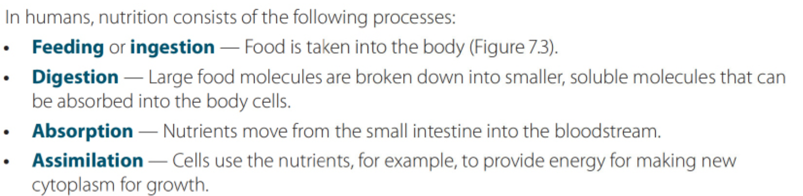
Terms to be defined:

Slide 21
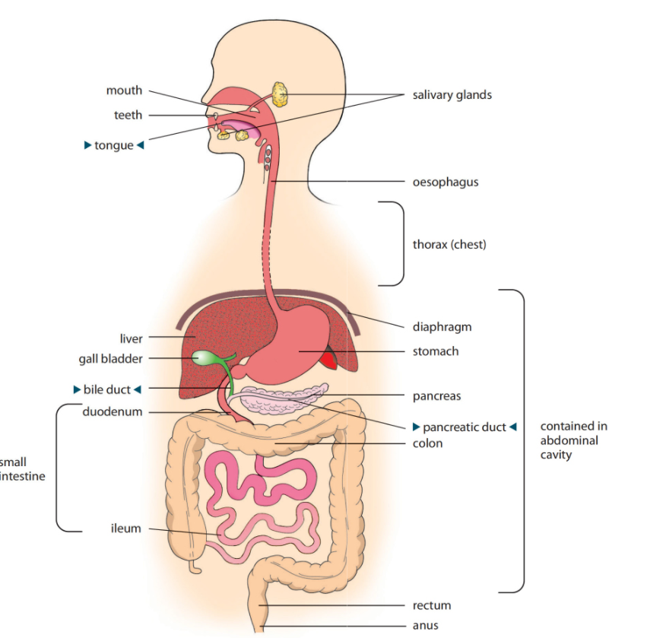
Human Digestive System

Slide 22
Human Digestive System
Human digestive system consists of :
1- Alimentary canal: is a long tube that extends from the mouth to the anus with most of its length coiled in the abdomen.
2- Organs : liver and pancreas

Slide 23
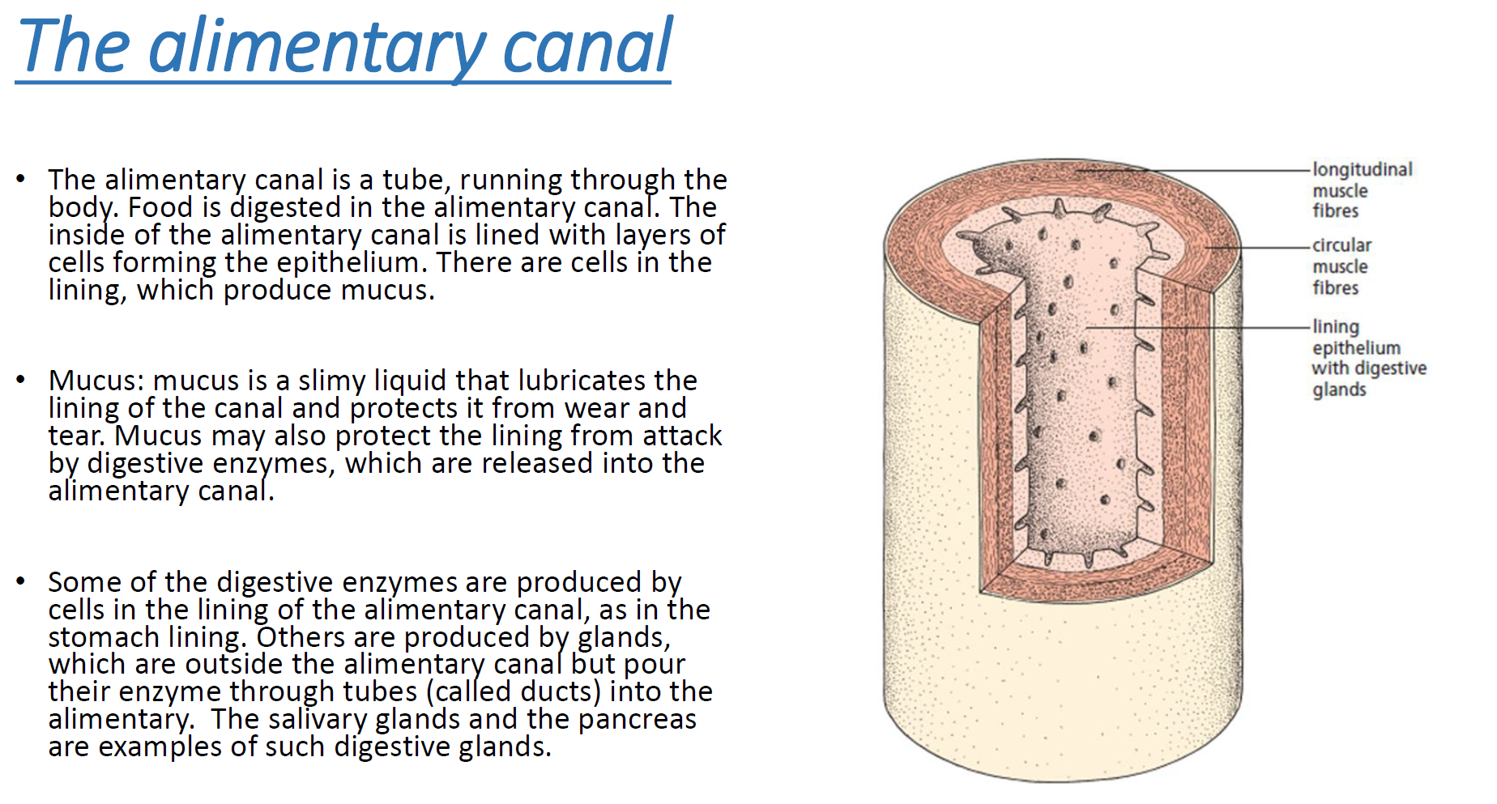

Slide 24
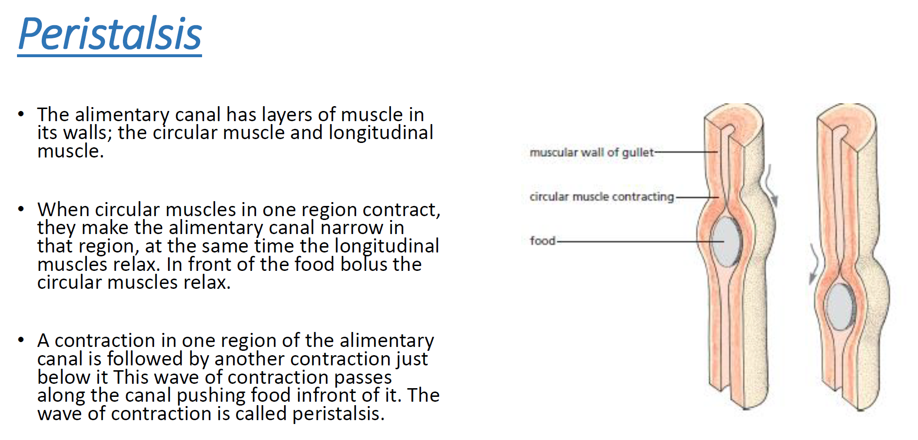

Slide 25
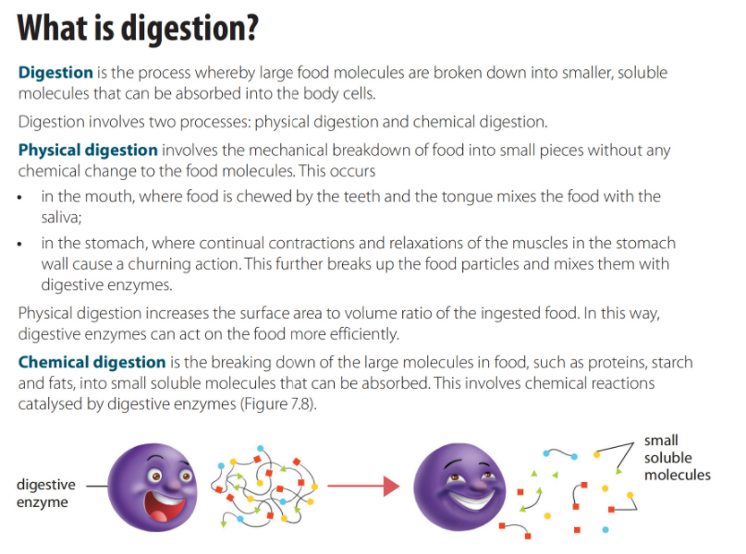

Slide 26
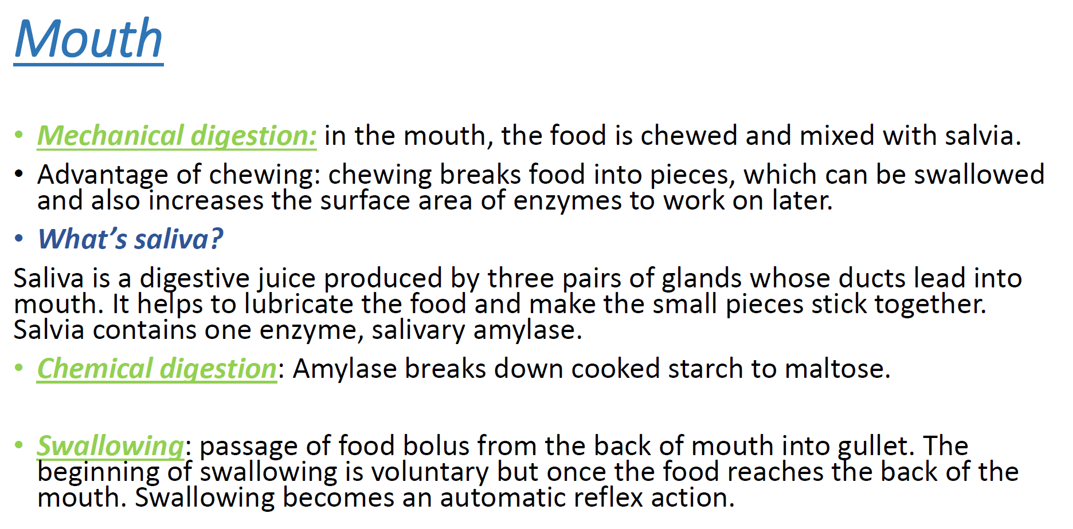

Slide 27
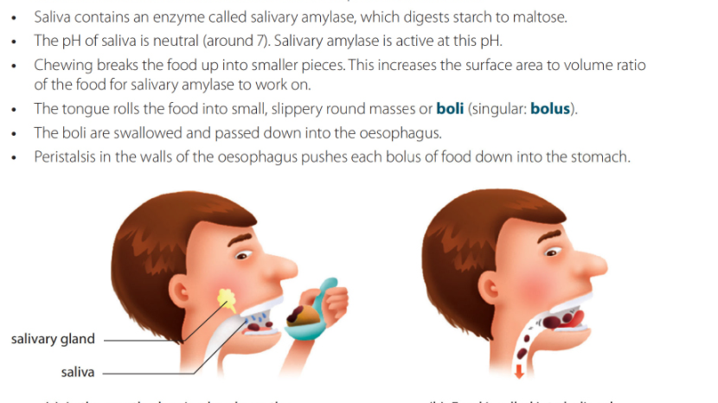

Slide 28
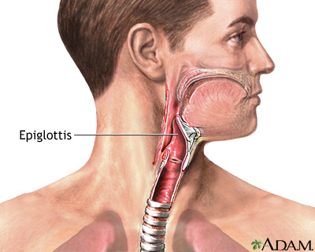
Epiglottis

Slide 29
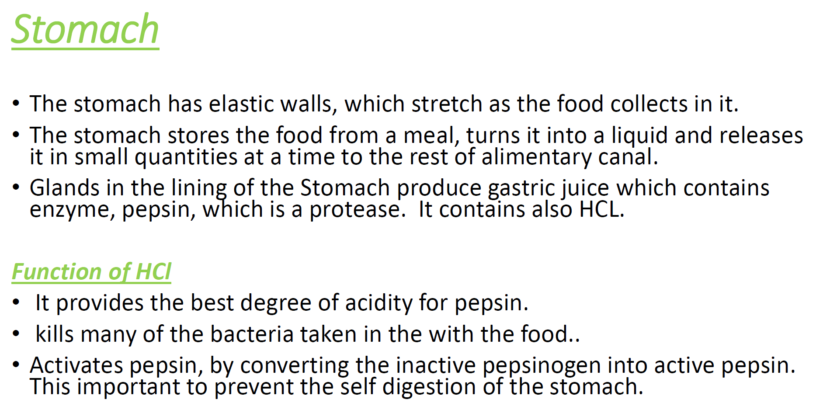

Slide 30
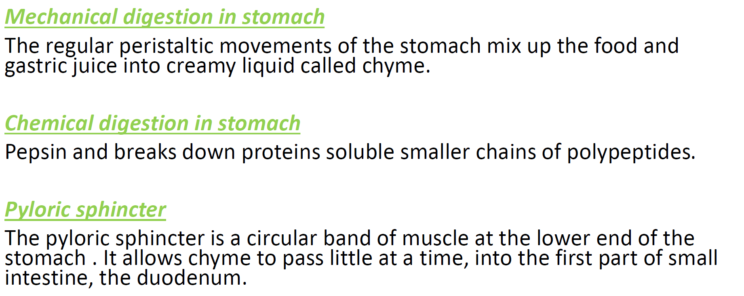

Slide 31
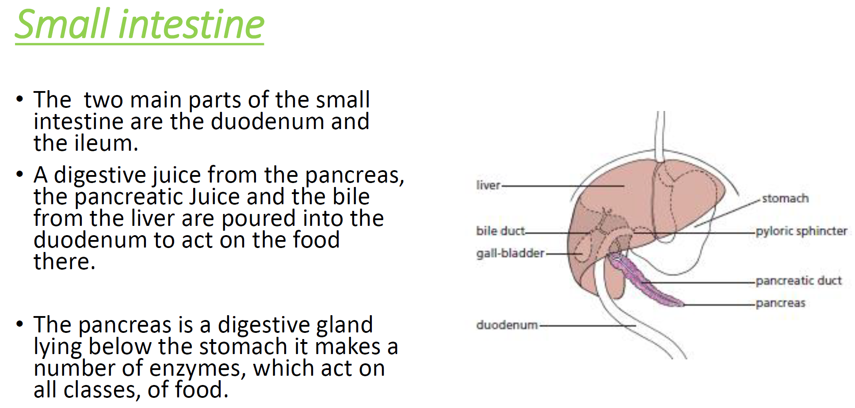

Slide 32
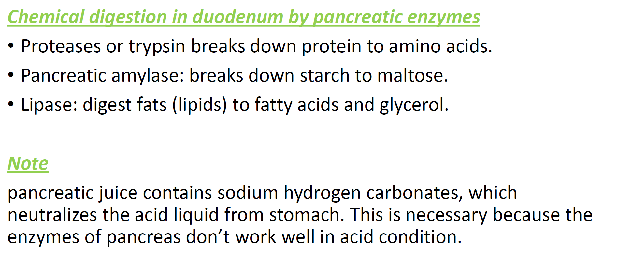

Slide 33
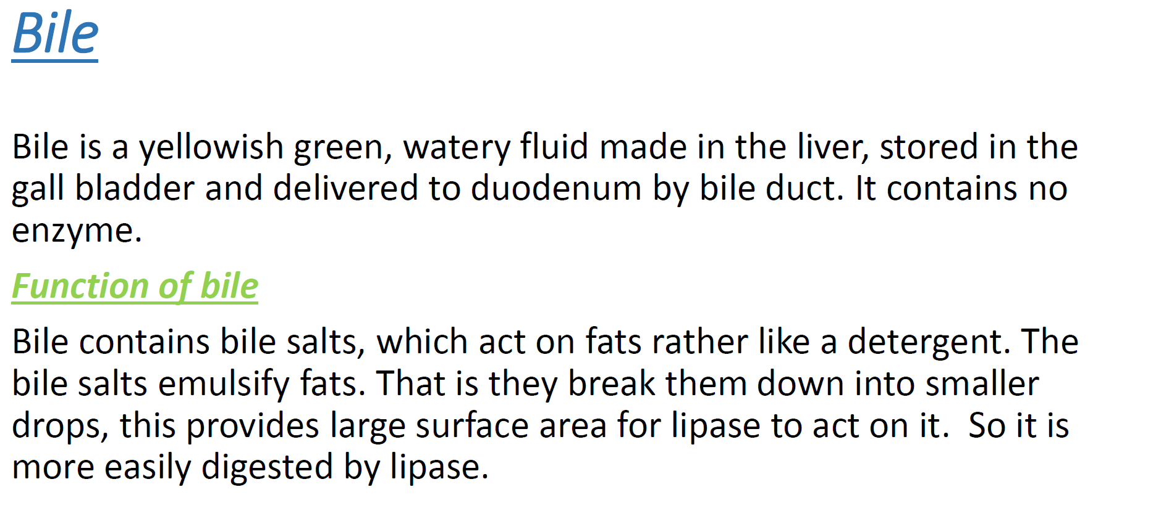

Slide 34
Region of Digestion | Secretion | Source | Enzyme | Action | pH
Mouth | Saliva | Salivary Gland | Salivary Amylase | Starch-→maltose | Neutral [7]
Stomach | Gastric Juice | Gastric Glands | Pepsin | Protein→polypeptides | Acidic[1.5-2]
Small Intestines | Bile | Liver | No enzymes | Emulsifies fats | Alkaline[8.5]
 | Pancreatic Juice | Pancreas | Trypsin | Protein-→polypeptides
 |  |  | Lipase | Fats--→fatty acids and glycerol
 |  |  | Pancreatic Amylase | Starch-→maltose
 | Intestinal Juice | Epithelial cells | Maltase | Maltose-→ Glucose
 |  |  | Lipase | Fats-→ fatty acids and glycerol
 |  |  | Protease | Polypeptides-→amino acids

Slide 35
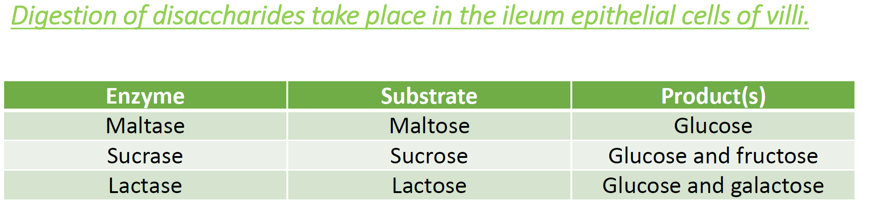

Slide 36
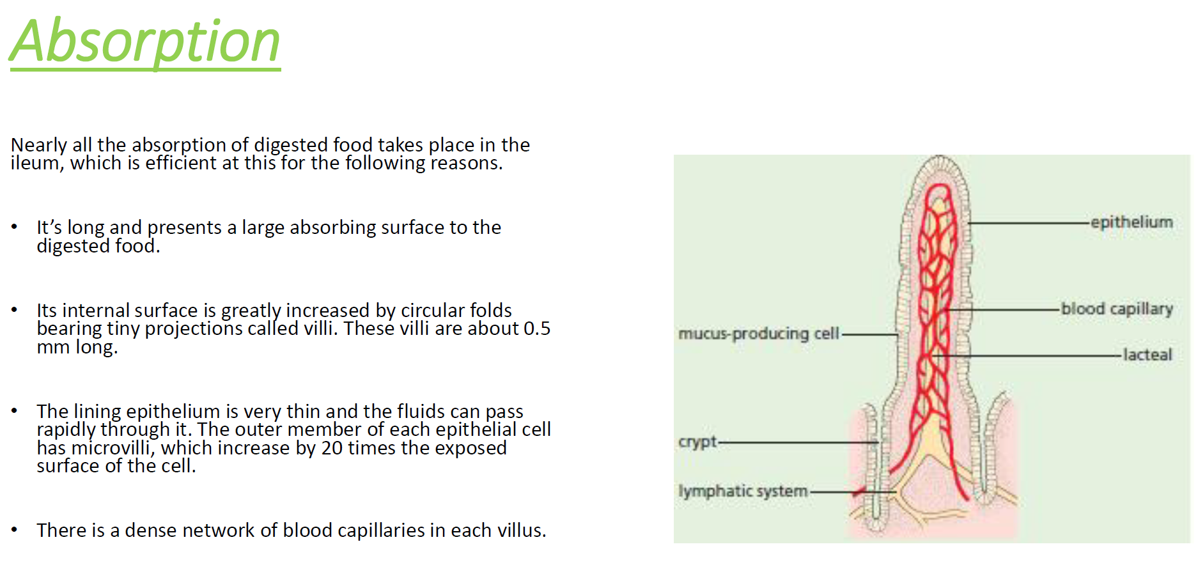

Slide 37
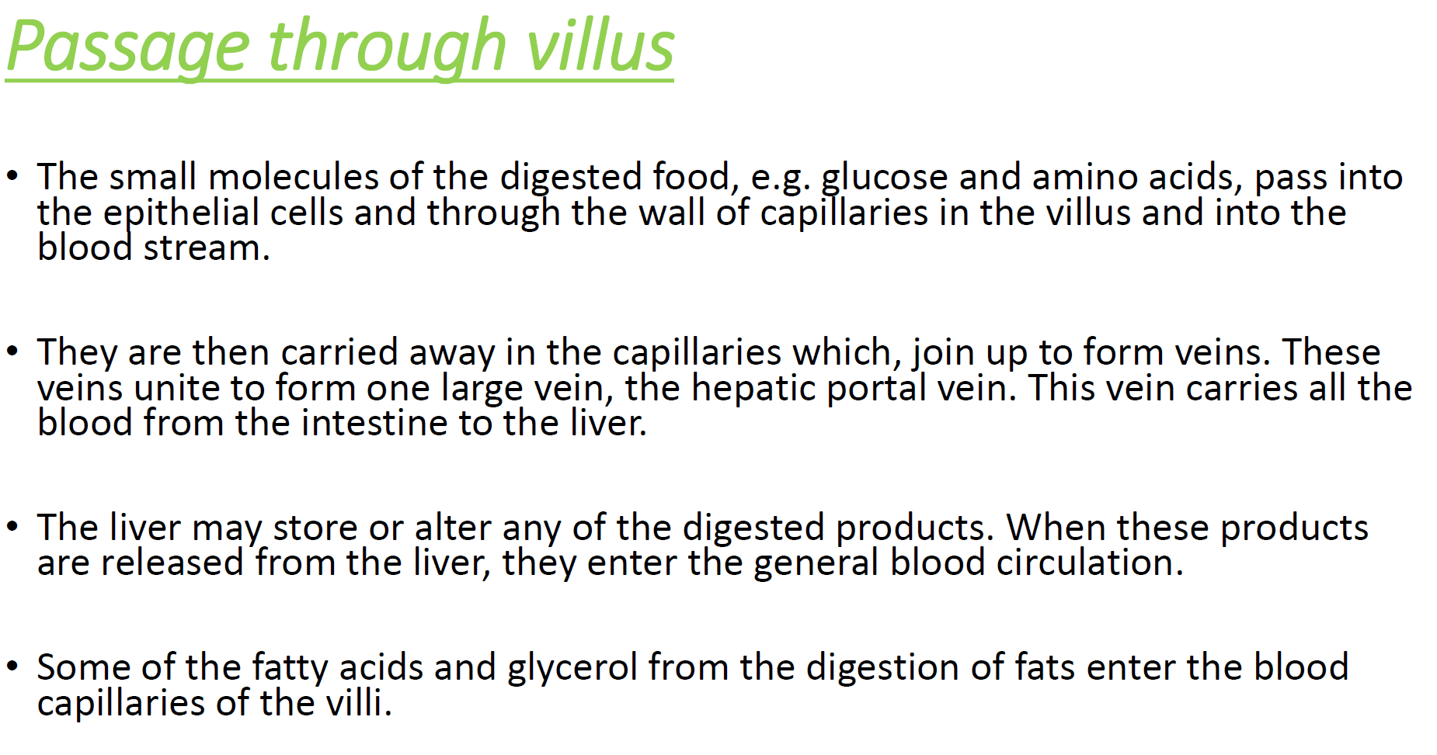

Slide 38
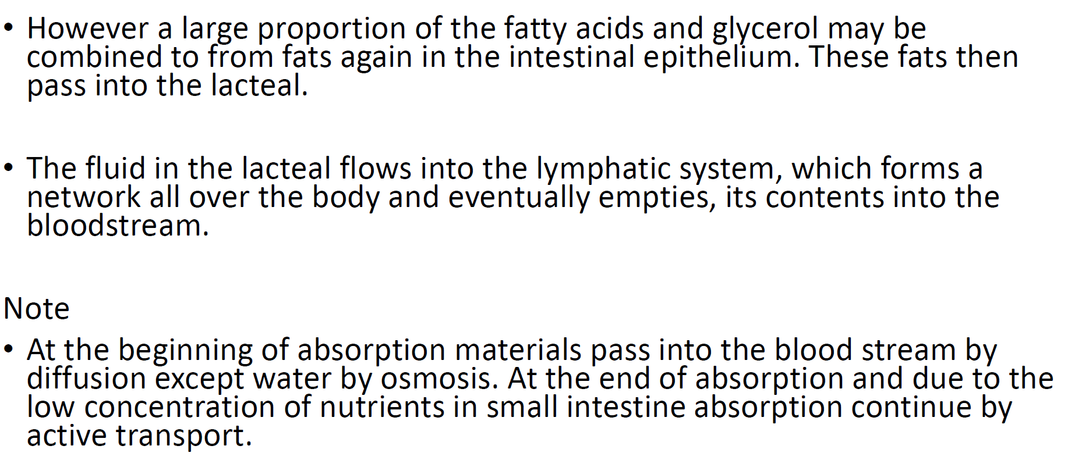

Slide 39
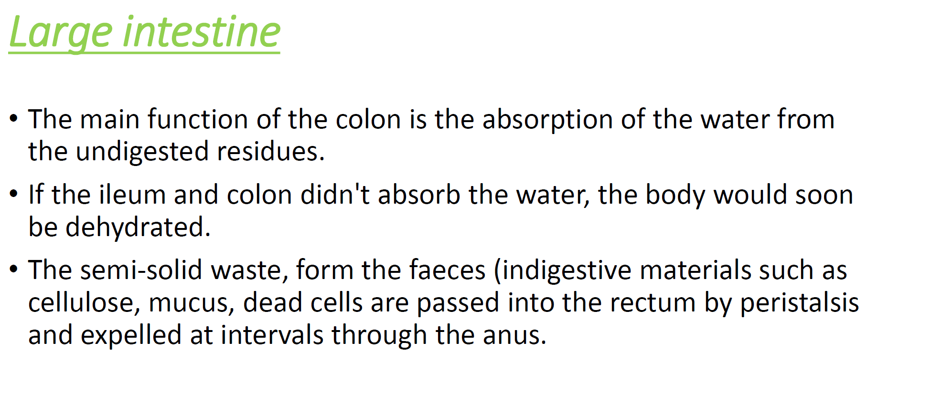

Slide 40
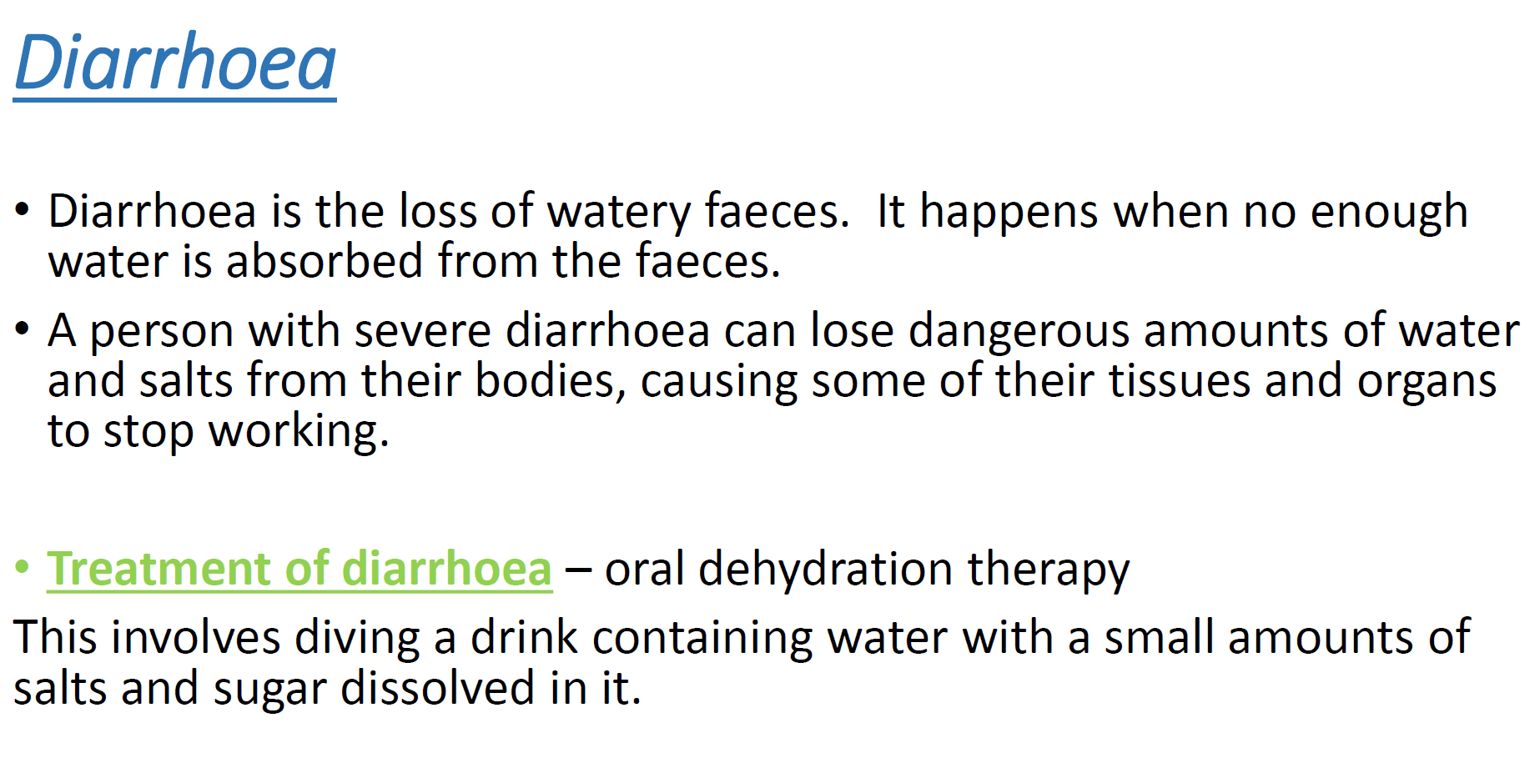

Slide 41
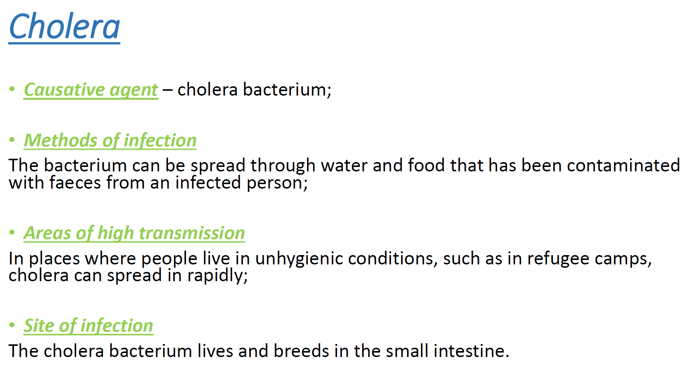

Slide 42
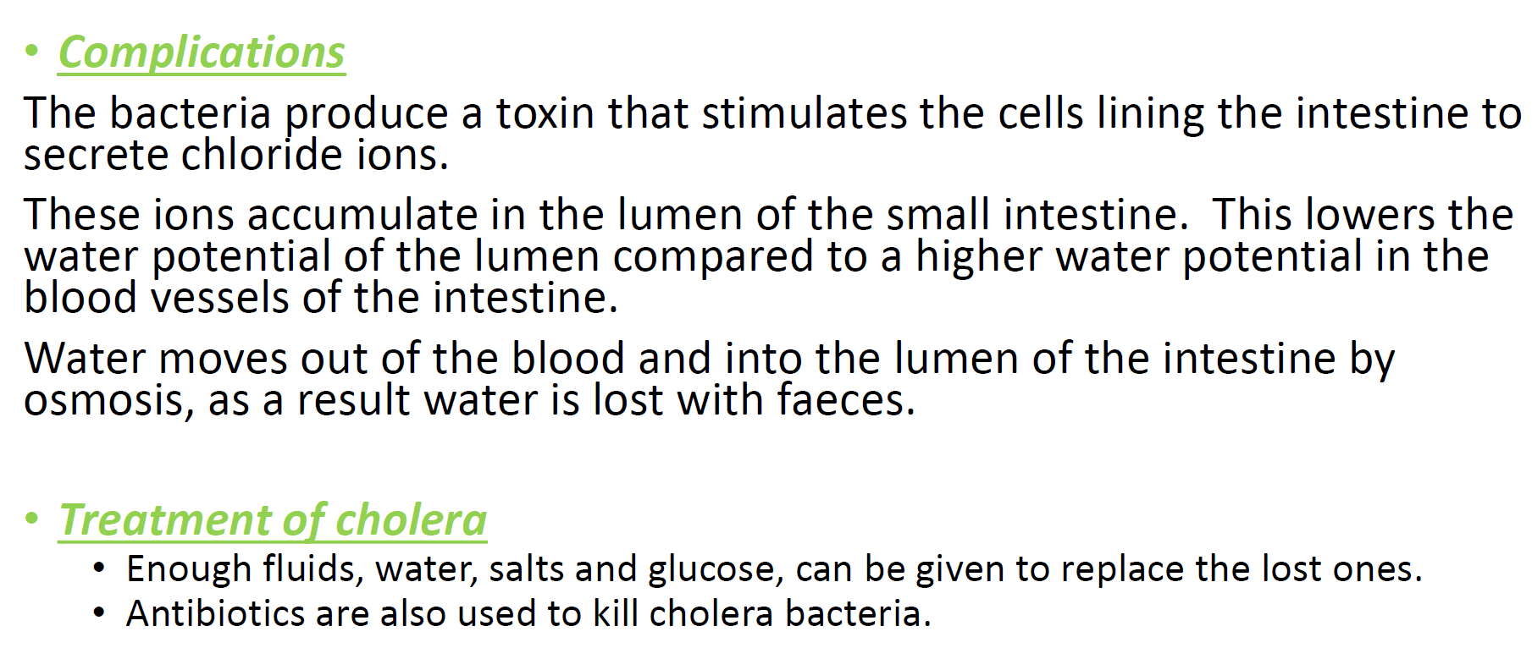

Slide 43
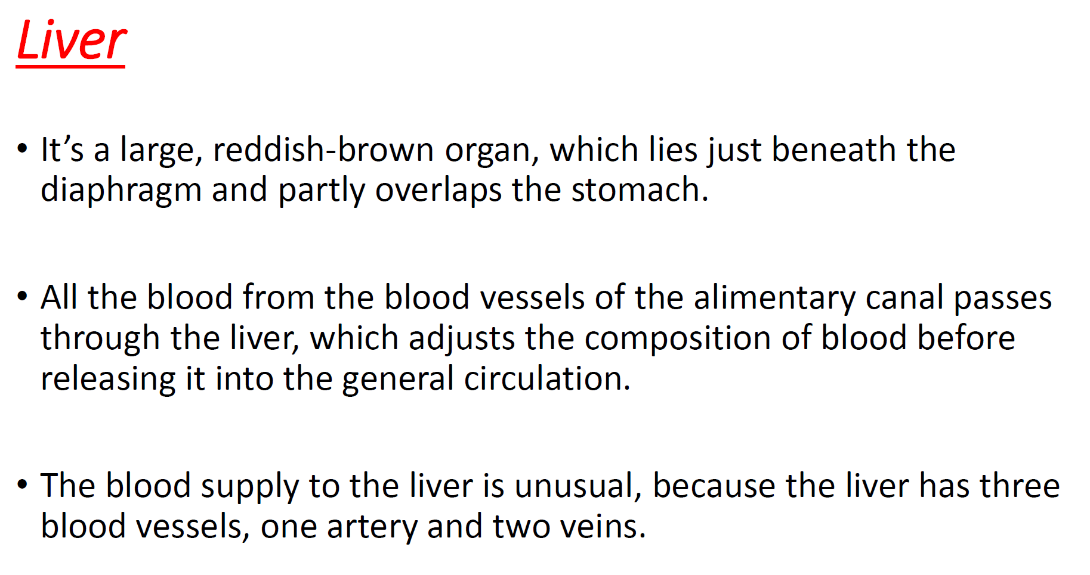

Slide 44
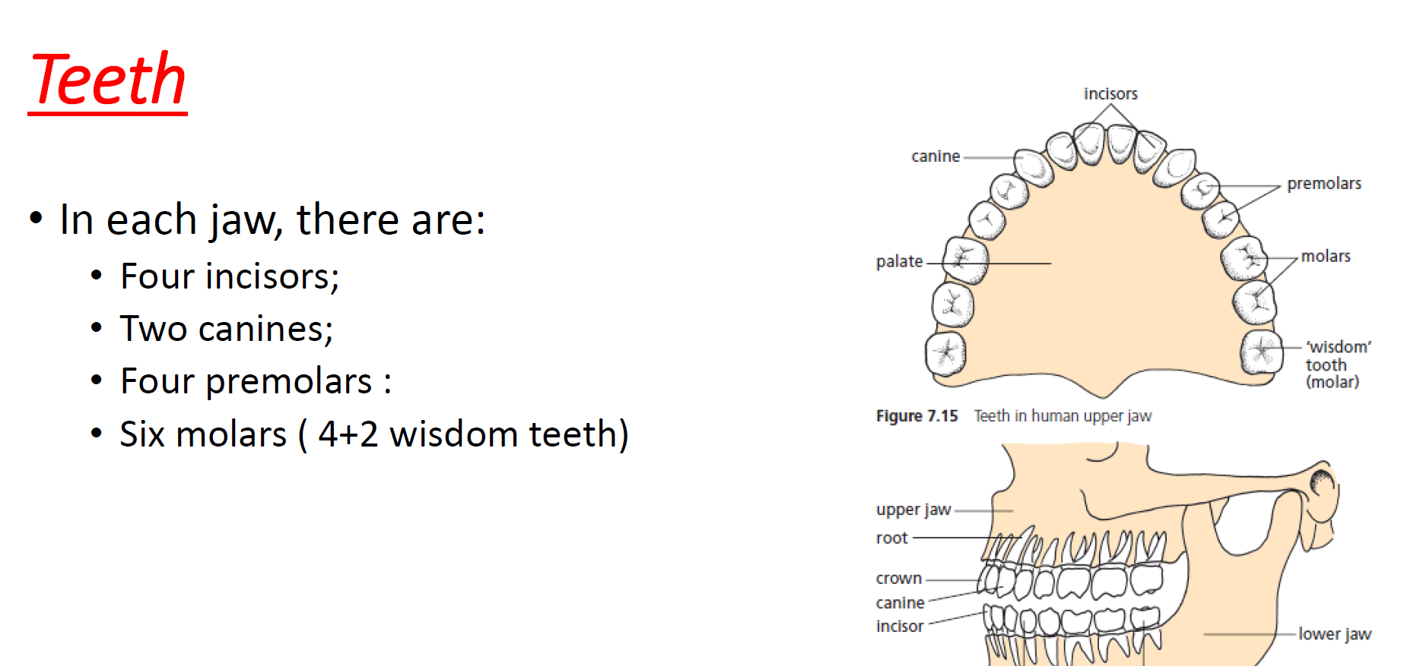

Slide 45
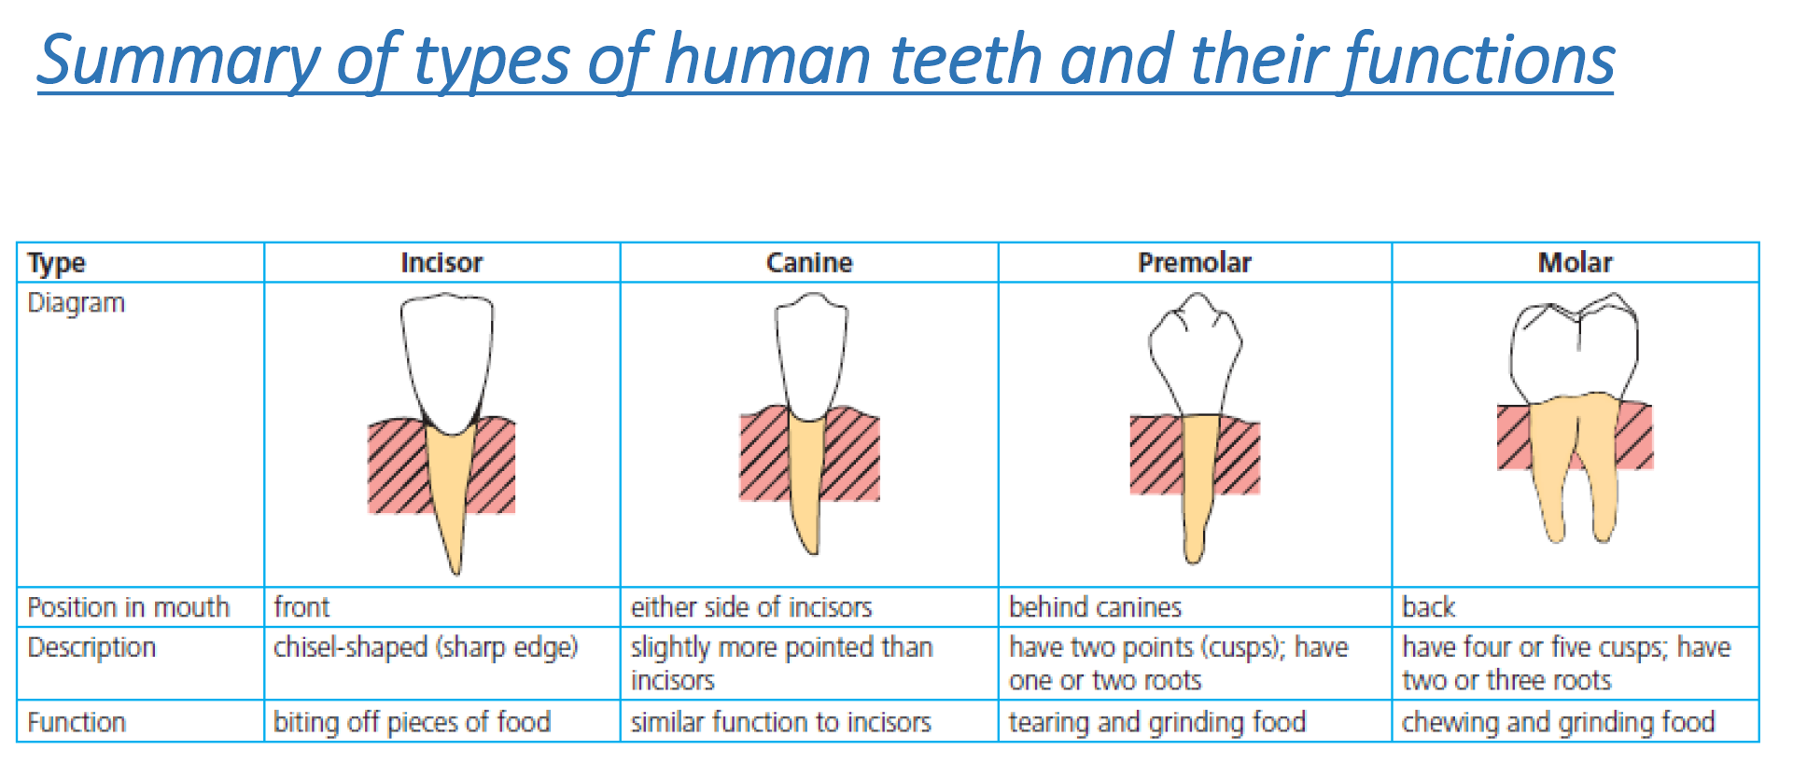

Slide 46
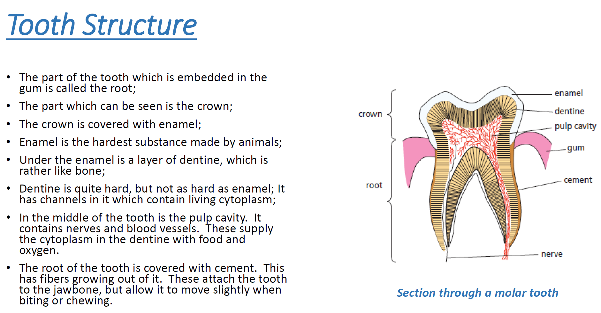

Slide 47
